Slide 1






Introduction to AI and Data science
Peng, Miao
21 Feb, 2025
Personal Website: https://www.miaopeng.info/
Email: miaopeng@stu.scu.edu.cn
Github: https://github.com/MMeowhite
Youtube: https://www.youtube.com/@pengmiao-bmm

Slide 2
1. Artificial Intelligence
2. Machine Learning
3. Deep Learning
4. Machine Learning vs Deep Learning
5. Extension: Data Science

Slide 3
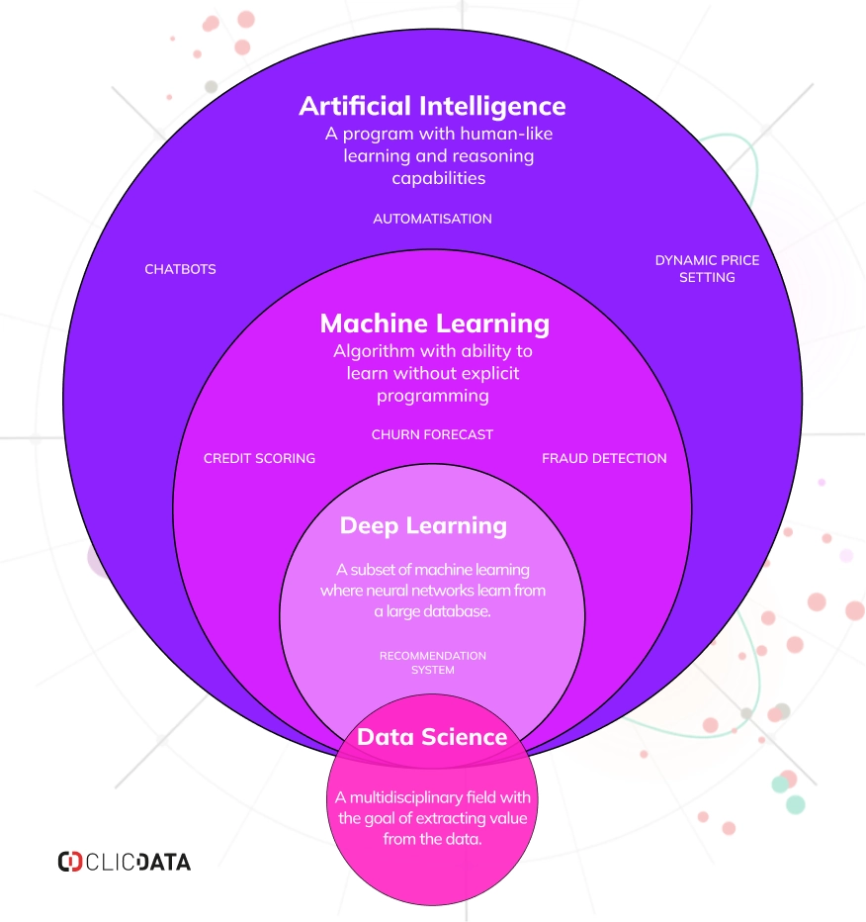
1. Artificial Intelligence
Definition: Artificial Intelligence (AI) is the simulation of human intelligence processes by machines, particularly computer systems. These processes include learning (the acquisition of information and rules for using it), reasoning (using rules to reach approximate or definite conclusions), and self-correction.
Application: Artificial General Intelligence(AGI) / strong Artificial Intelligence [Features: self-learning, mind, inference, wide adaption]
Fields: Supervised and Unsupervised Learning, Large Language Model (LLM), Computer Vision (CV), Reinforcement Learning (RL) etc.
Source: https://www.clicdata.com/wp-content/uploads/2024/06/ai-ml-deep-learning-data-science-relationship.webp

Slide 4

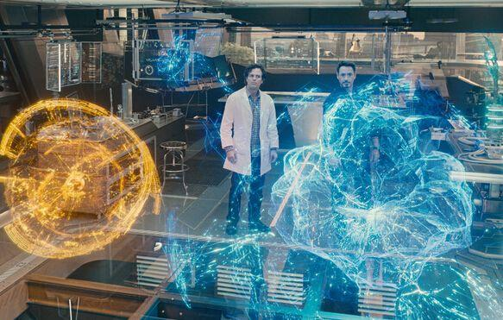
1. Artificial Intelligence
Tony Stark:“J.A.R.V.I.S., are you there?”
J.A.R.V.I.S: “I’m always on standby.”
Ultron: “What do you want, J.A.R.V.I.S.? You want me to stop? You want me to stop? No, no, no, no. You’re a relic. You’re a second-rate mind trying to be a first-rate mind.”
J.A.R.V.I.S: “I am not a mind. I am an intelligence.”
Source: 《Avengers: Age of Ultron》

Slide 5
2. Machine Learning
Definition: Machine learning is a subset of AI that focuses on the development of algorithms that allow computers to learn from and make predictions or decisions based on data.
Application: Chatbots(ChatGPT-4o, Deepseek-R1), Personalized Medicine, Self-Driving etc.
Key skills: Machine Learning Algorithms, Big Data, Model Evaluation
Source: https://www.clicdata.com/wp-content/uploads/2024/06/ai-ml-deep-learning-data-science-relationship.webp

Slide 6
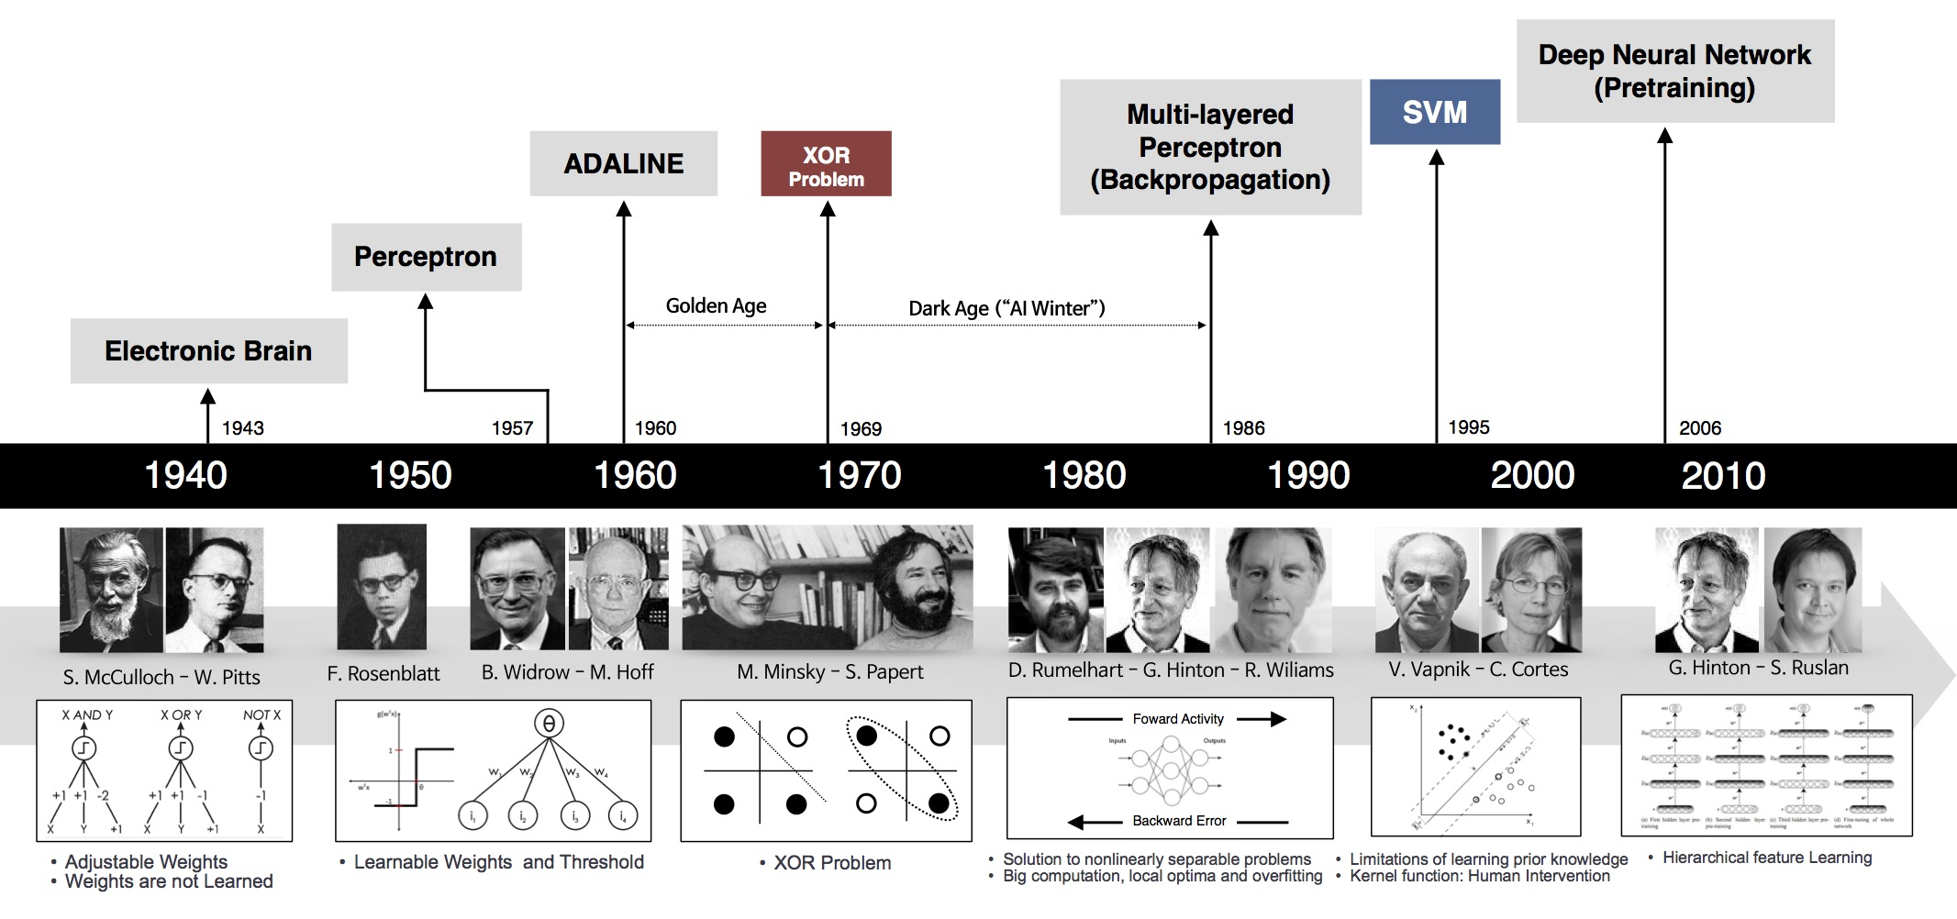
2. Machine Learning
The development of deep learning encapsulates the brilliant contributions of countless geniuses across various fields
Source: http://beamlab.org/images/deep_learning_101/nn_timeline.jpg
Development stage: Computer invention -> Perceptron -> Multi-layered Perceptron -> SVM -> Deep Neural Neural Network -> Transformer
Recommendation reading: DEEP LEARNING 101 - PART 1: HISTORY AND BACKGROUND

Slide 7
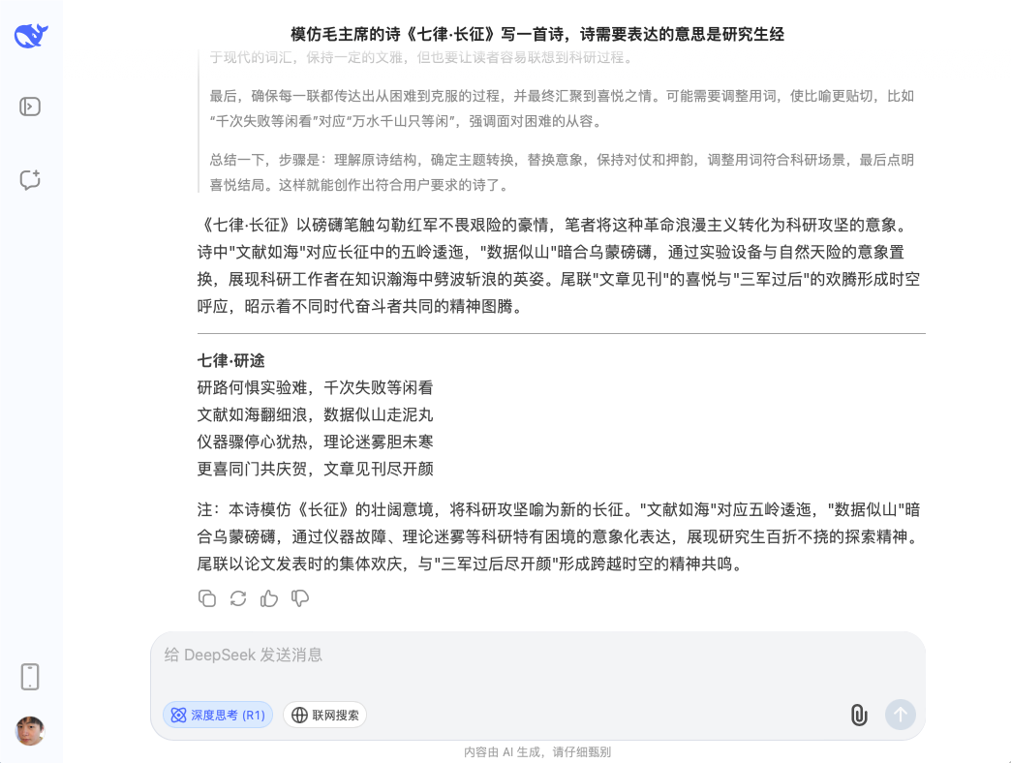
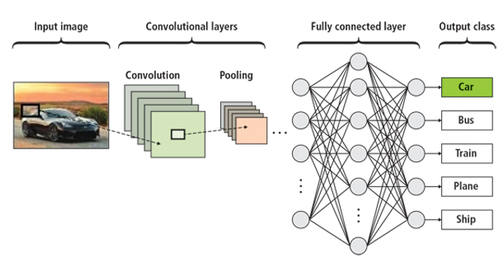
2. Machine Learning
Chatbots: a deep learning-based search algorithm designed to efficiently extract relevant patterns and insights from large datasets or unstructured data.
Computer vision: a field of artificial intelligence that enables machines to interpret, understand, and make decisions based on visual data from the world, such as images or videos, simulating the human visual system.

Slide 8
3. Deep Learning
Definition: Deep learning is a subset of machine learning that involves neural networks with many layers (deep neural networks). These networks are capable of learning from vast amounts of data and are particularly useful in tasks such as image and speech recognition.
Application: Image and Video Recognition, Natural Language Processing (NLP)
Key skills: Neural Networks Algorithm
Source: https://www.clicdata.com/wp-content/uploads/2024/06/ai-ml-deep-learning-data-science-relationship.webp

Slide 9
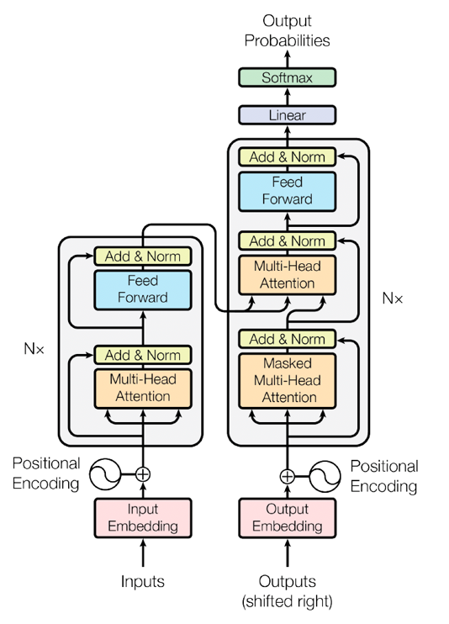
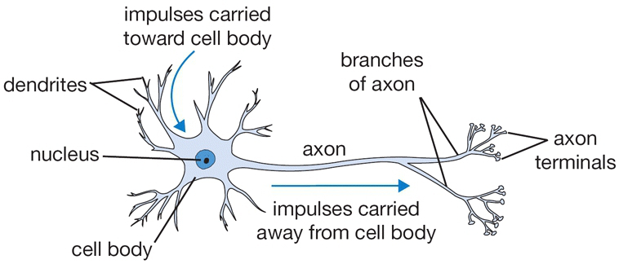
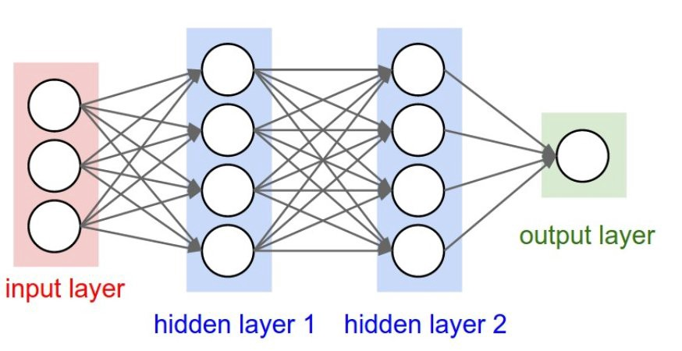
3. Deep Learning
Source: https://getthematic.com/insights/what-is-deep-learning/
Vaswani et al., 2017. Attention is All You Need. NeurIPS. arXiv:1706.03762
Neural Networks Model
Transformer Model

Slide 10
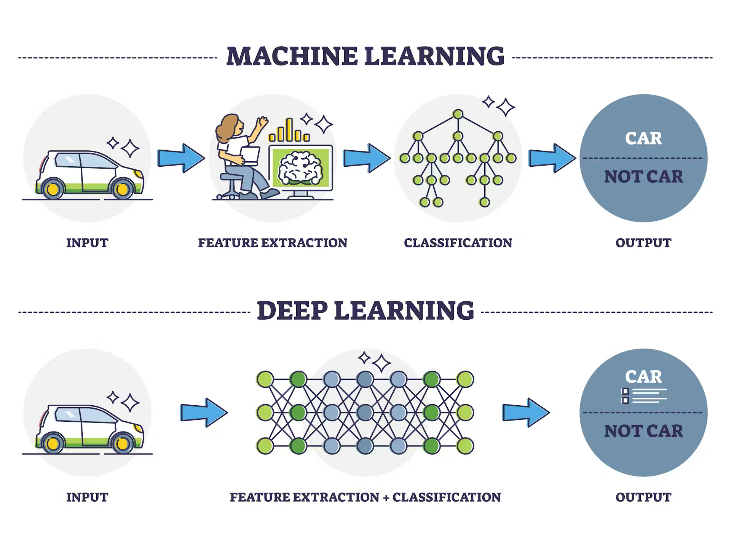
4. Deep Learning vs Machine Learning
Machine Learning : Involves two separate steps where feature extraction is done manually by humans before classification.
Deep Learning: Uses a neural network to automatically handle both feature extraction and classification in a single integrated step.

Slide 11
5. Extension: Data science
Definition: Data Science encompasses all things related to data when it is used for analysis and decision-making purposes.
Application: Big Data Model, Weather Prediction, Finance Evaluation, Reading Recommendation etc.
Key skills: Neural Networks, Data Scarping, Clean and Visualization
Source: https://www.clicdata.com/wp-content/uploads/2024/06/ai-ml-deep-learning-data-science-relationship.webp
Recommendation course: UCB Data100: Principles and Techniques of Data Science

Slide 12
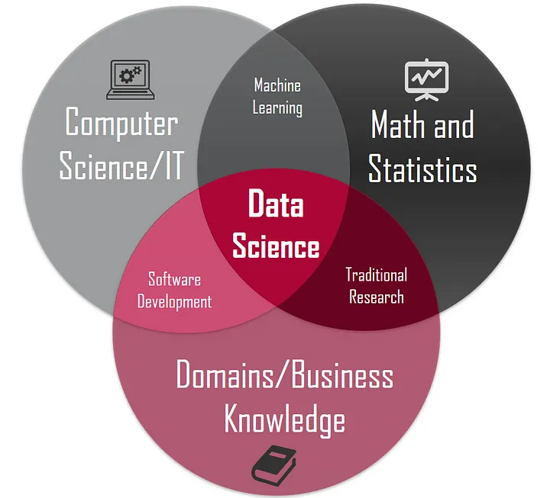
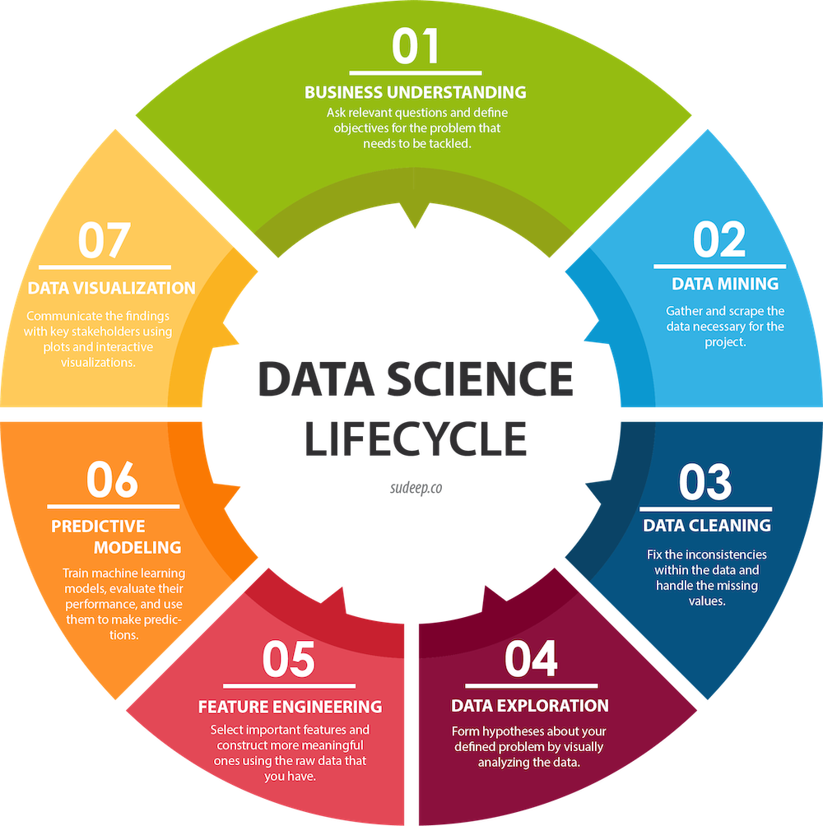
5. Extension: Data science
Source: https://jaro-website.s3.ap-south-1.amazonaws.com/2024/04/1-mgXvzNcwfpnBawI6XTkVRg.webp
Source: https://www.sudeep.co/images/post_images/2018-02-09-Understanding-the-Data-Science-Lifecycle/chart.png
The data science is a circle operation with multiple processing steps.
The data science is center in many research field.
Notes:
代谢物积累破坏氧化呼吸链

Slide 13

Thanks!
If you have any questions, contact me!
Personal Website: https://www.miaopeng.info/
Email: miaopeng@stu.scu.edu.cn
Github: https://github.com/MMeowhite
Youtube: https://www.youtube.com/@pengmiao-bmm

